Slide 1
Chapter 3: Creating your first Watson app
Learning Bluemix & Cognitive
Bob Dill, IBM Distinguished Engineer, CTO Global Technical Sales

Slide 2
Chapter 3: Building your first Watson App
Setting up your workstation
Clone the ‘Class’ repository
Getting your Speech to Text credentials
Creating the User Experience
Creating a simple service in NodeJS
Connecting your app to NodeJS
Connecting your app to Watson Speech to Text
Talking to your computer/iPhone

Slide 3
Setting up your workstation for nodeJS: Windows
There is a simple two step process to install nodeJS on Window:
Go to https://nodejs.org and click on the LTS (Long Term Support) image. at the time of this writing, the LTS version is 4.5.0 This will download a file named node-v4.5.0-x64.msi
Go to your Downloads folder (or other location if you told Windows to save the file somewhere else) and open the node-v4.5.0-x64.msi file. This will start the Windows Program Installer.
You’re done!

Slide 4
Setting up your workstation for nodeJS: OSX
I recommend that you start by installing the “homebrew” package manager for OSX. You’ll need to be connected to the internet to do this. Go to this site (http://brew.sh)and follow the directions to install Homebrew.
Type this into your terminal window:
/usr/bin/ruby -e "$(curl -fsSL https://raw.githubusercontent.com/Homebrew/install/master/install)”
If brew is already installed, you’ll get this message:
It appears Homebrew is already installed. If your intent is to reinstall you
should do the following before running this installer again:
ruby -e "$(curl -fsSL https://raw.githubusercontent.com/Homebrew/install/master/uninstall)"
update Brew
brew update
Install the Node Package Manager (npm)
brew install npm

Slide 5
Setting up your workstation for nodeJS: Linux
The following installation instructions are based on the Ubuntu Linux platform and use the “terminal” window.
Open a terminal window and enter the following commands:
sudo apt-get update
enter your log-in password when prompted
sudo apt-get install curl
enter your log-in password if prompted
curl -sL https://deb.nodesource.com/setup_4.x | sudo -E bash -
enter your log-in password if prompted
sudo apt-get install -y nodejs
create a symbolic link so that you can use either node, or nodejs to invoke the program:
sudo ln -s /usr/bin/nodejs /usr/bin/node
Verify the installation:
npm -v (should return a value like v2.15.8)
node -v (should return a value like v4.4.47)

Slide 6


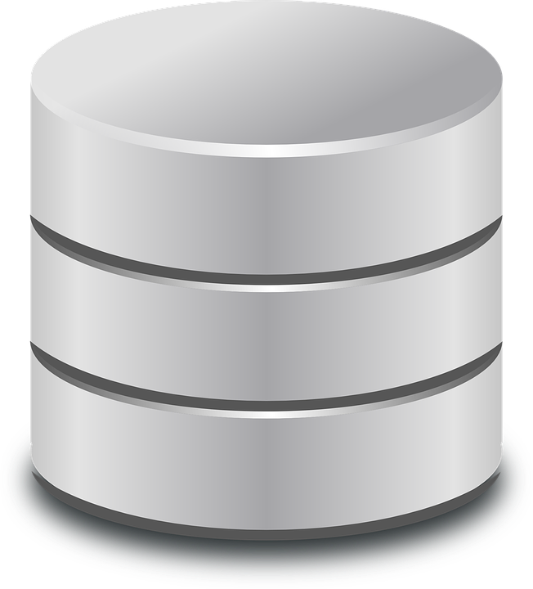
Getting the code: step 1
This activity has the pre-requisite that you have already successfully installed Git and completed the process to allow Git to authenticate to our GitHub Enterprise service.
You have two options to retrieve information from GitHub:
Clone the repository. This makes a copy of the repository on your laptop. If you want to work with this in your own repository, you would then copy the contents of the clone into your own folders.
Fork the repository. This creates your own personal version of the repository and allows you to make updates and store your updates in your version of the Z2C repository. We will use this option.
IBM GitHub Enterprise
The Internet
IBM Intranet
rddill/Z2C Repository
rddill/Z2C Repository
IBM GitHub Enterprise
The Internet
IBM Intranet
rddill/Z2C Repository
YOURID/Z2C Repository
YOURID/Z2C Repository
￼

Slide 7

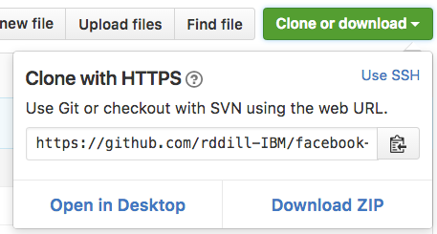
Getting the code: step 2
You’ve successfully forked the repository… what happened?
GitHub created a copy of the repository, prefaced by your github short name. You’ll see this in the top left corner of the new github browser page. For example, when I fork the Bluemix/photoanalyzer repository, I see the following:
Clone YOUR repository to your desktop by pressing the (green) Clone button the right hand side of the web page and then selecting “Open in Desktop”. GitHub Desktop will automagically open and show you where the file is going. Press Enter
On Windows and OS X, git defaults to the following path: Documents/GitHub/your-repository-name
￼

Slide 8
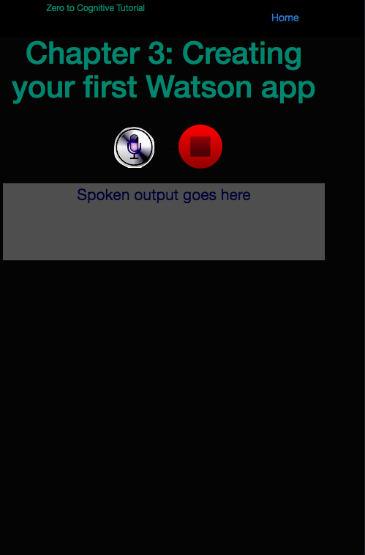
Set up Node and the Watson SDK
You’ve got the code on your system, now let’s make it work locally.
Open a terminal window and change to the directory for your new, forked, repository.
cd ~/Documents/GitHub/ZeroToCognitive/Chapter03/
npm install
This tells npm to look at your ‘package.json’ file and make sure that everything in that file is available to node.
npm install watson-developer-cloud —save
This tells npm to go find a node package called ‘watson-developer-cloud’ and install it locally. Then add an entry to your package.json file. This becomes important later on.
Did it work? Type the following command into your terminal window:
node index.js This should respond with “z2c-chapter03 is listening on port: 6003”
This means that you should be able to point your browser to localhost:6003 and see the page to the right.
Let’s look at the code … and then make it do something.
￼

Slide 9
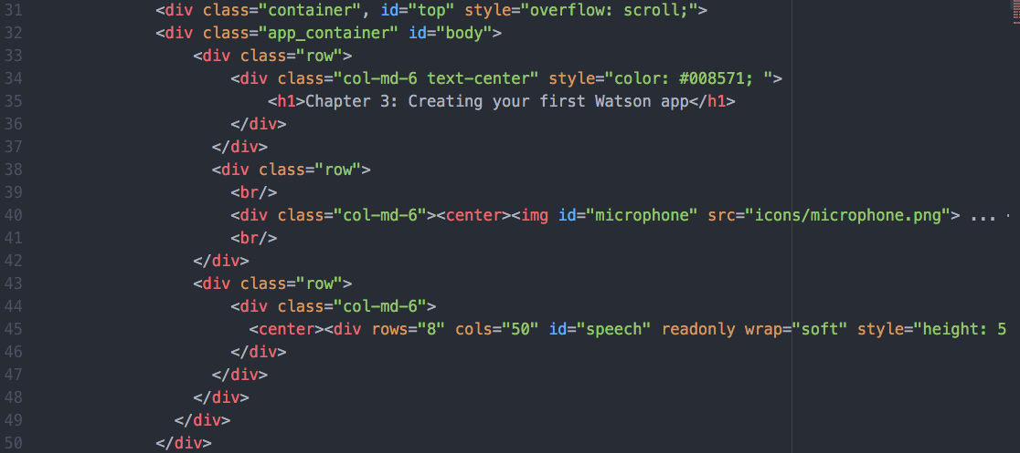
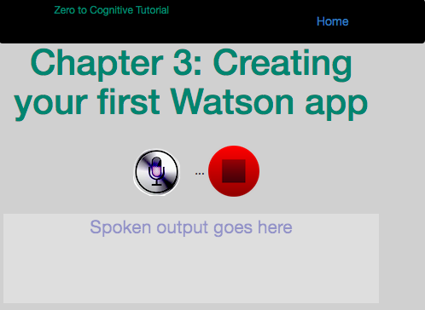
The html file
The default file loaded by a server is “index.html”. You’ll find it in the “Chapter03/HTML” folder.
The top navigation bar is managed by lines 9 to 30 … we’ll come back to them in a later chapter.
What you see in the browser is managed by lines 31 to 50
Lines 53 to 59 provide some framework support and manage the colors and shapes which you see.
Let’s start with a simple change. update the background from near black to a lighter color
Open index.html in your favorite browser and search for body class=“tutorial"
The word tutorial tells your browser that it can update the visual characteristics of ‘tutorial’ if the CSS (Cascading Style Sheet) file has an entry for it.
Open the pageStyles.css file in the Chapter03/HTML/CSS folder and search for the word tutorial. You’ll see the following line: .tutorial {background: #040404; color: #000000;}
Change the #040404 to #D0D0D0 and save the file to the same location and name.
“Shift-reload” your browser (pressing the Shift key while clicking on the reload button tells the browser to go back to the server.
Your page now has a new background. Congratulations.

Slide 10
Making the page do something…
Nothing happens when anything on the page is clicked. We need to create function on the server and in the browser to make the web page work.
Let’s look at the server code, Chapter03/index.js which has 4 basic parts:
lines 19-32 define core variables and ensure that base capability is available
lines 34-47 set up the application for your local environment.
we’ll update lines 38-41 to move between Bluemix and local execution.
Later we’ll write a routine to automate that switch
lines 54-57 create the web server. (really, only 4 lines of code????)
lines 59-73 handle file loading for the server (html, icons, javascript, css)
On the client side, everything gets kicked off by the browser after the web page has completed loading. This is defined in the “<body>” tag by stating: onLoad=“initPage()"
So where is initPage() and what does it do?
look in z2c-speech.js (HTML/js/z2c-speech.js) and you’ll seen an empty routine, which looks like this:
function initPage () { }
We need to do the following things:
monitor the microphone and stop buttons
connect to Watson and display what is said.

Slide 11
Activating the microphone
Enable the microphone, disable the stop button:
var _mic = $('#microphone'); var _stop = $("#stop");
_mic.addClass("mic_enabled");
_stop.addClass("mic_disabled");
Monitor the microphone button for a click:
_mic.on("click", function ()
{
var _className = this.className;
if(this.className == "mic_enabled")
{
_mic.addClass("mic_disabled");
_mic.removeClass("mic_enabled");
_stop.addClass("mic_enabled");
_stop.removeClass("mic_disabled");
$.when($.get('/api/speech-to-text/token')).done(
function (token) {
stream = WatsonSpeech.SpeechToText.recognizeMicrophone({
token: token,
outputElement: '#speech' // CSS selector or DOM Element
});
stream.on('error', function(err) { console.log(err); });
});
}
});
Enable the microphone, disable the stop button:
These two add class statements are monitored by CSS and change how the button looks
Monitor the microphone button for a click:
Do something when the microphone is clicked
But ignore the click if the microphone has been disabled by the app.
Disable the microphone
Enable the stop button
Remove conflicting class
Remove conflicting class
Call the server using an http get and go to the /api/speech/ folder and execute token
Give the token to the Watson API to monitor the microphone
Direct output to go back to the #speech element in the index.html file
If there is an error, print the error message to the browser console log.

Slide 12
Activating the microphone
Monitor the Stop button for a click:
_stop.on("click", function() {
console.log("Stopping text-to-speech service...");
if (stream != undefined) {stream.stop(); }
_mic.addClass("mic_enabled");
_mic.removeClass("mic_disabled");
_stop.addClass("mic_disabled");
_stop.removeClass("mic_enabled");
});
Monitor the stop button for a click:
Do something when the microphone is clicked
write a message to the log file to record the click
If a stream is active, stop processing voice.
enable the microphone button
disable the stop button
remove conflicting class
remove conflicting class
You will have noticed that there are quite a few places in this code where the code includes “$(“ or “$.” This is a javascript framework called jQuery. We’re using jquery version 3.1.0 in this demo. The demo is not dependent on that specific version and you are welcome to upgrade to the latest version.
jQuery Foundation website: https://jquery.org/
jQuery code website: http://jquery.com

Slide 13
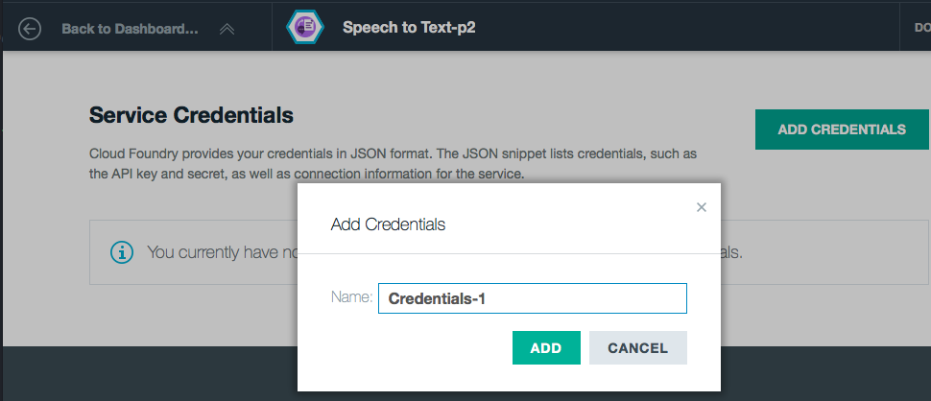
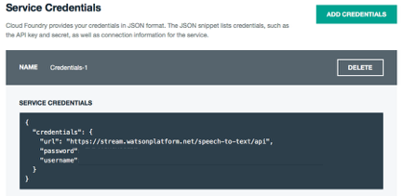
Activating Watson
There are two actions to take here:
Get the Watson Speech-to-Text credentials from Bluemix
Write some code to access those credentials and connect to Watson Speech-to-Text
Get the Watson Credentials from Bluemix
Log in to your Bluemix account
Click on Dashboard
Click on the space you created
Click on Services
Click on Watson Speech-to-Text
Click on Service Credentials
Click on Add Credentials
Copy the returned credentials into your index.js file
In the preceding section, we saw that the browser send a get request to “/api/speech/token”. Since it doesn’t exist, we need to create it.

Slide 14
Creating the server code in NodeJS
We have two basic approaches we can use to write the code on the server side.
put it directly in NodeJS, it’s only 20 or so lines, so no big deal right?
Put it in a separate file
Which to choose? I use architectural principles to help me make decisions like this. Several that I find invaluable on any project are:
Separation of concerns
Loose coupling
Design for reuse
These tell me that it would be better to put this code in a separate file rather than putting it in the core index.js file. So, let’s do that.
In your github folder, you’ll see the following directory structure:
controller/restapi/features
In the features folder, you’ll see one file: speech_to_text.js
We need to tell index.js where to look for this file and we need to put real code in there.
In index.js, add the following lines of code:
app.use('/', require("./controller/restapi/router"));
This tells node.js two things:
load the router.js file from the ‘restapi’ folder
Do this whenever a URL is requested.
var express = require('express');
var router = express.Router();
var speech_to_text = require('./features/speech_to_text');
module.exports = router;router.get('/api/speech-to-text/token*',speech_to_text.token);
This is a node.js router service.
Look in a subfolder called features for a file called speech_to_text.js
Export /api/speech-to-text/token* as a known path to nodes (this is what the browser javascript code calls

Slide 15
The Watson Speech-to-Text code
var extend = require('extend');
var watson = require('watson-developer-cloud');
var vcapServices = require('vcap_services');
var config = require('../../env.json');
exports.token = function(req, res) {
var sttConfig = extend(config.speech_to_text, vcapServices.getCredentials('speech_to_text'));
var sttAuthService = watson.authorization(sttConfig);
sttAuthService.getToken({
url: sttConfig.url
}, function(err, token) {
if (err) {
console.log('Error retrieving token: ', err);
res.status(500).send('Error retrieving token');
return;
}
res.send(token);
});
}
Include essential nodeJS services
get credentials to talk to Watson
Tell nodeJS how to get the token
Define the authorization service
Get the Token
Send the token back to the browser

Slide 16
The env.json file
{
"speech_to_text": {
"version": "v1",
"url": "https://stream.watsonplatform.net/speech-to-text/api",
"username": “your.Speech-to-Text.user.name.from.Bluemix”,
"password": “your.Speech-to-Text.password.from.Bluemix”
}
}
Put your credentials here

Slide 17
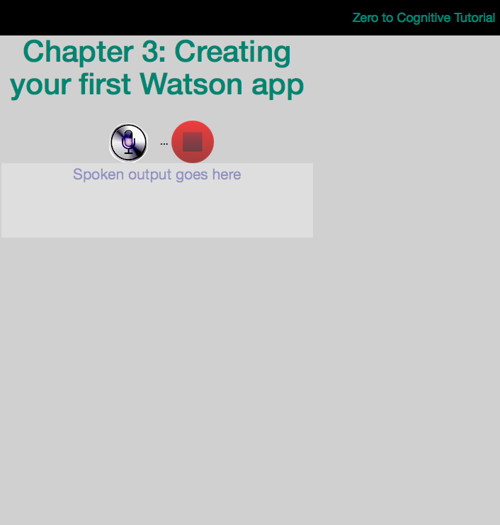
You've done it!
in your terminal window, type: nodejs index.js
your application should respond with:
Go to your browser (Chrome or FireFox. Safari does not work!) and type localhost:6003 as your url. You should see a web page like the one to the right appear.
Click on the microphone icon. Your browser should ask you if it’s OK to use the microphone - make sure you pick the one you want to use. Please see this video if you’re using Chrome to activate your microphone. http://w3.tap.ibm.com/data/medialibrary/additional/159501.mp4/60286/Enable_Microphone_in_Chrome.mp4
Start Talking!
Congratulations! You’ve completed your first Watson app!

Slide 18
Saving your work
Saving your work:
go to the terminal window running node-js
Stop nodejs (CTRL-C).
Type git status.
Using git add, add each of the changed files to git.
Type git status when you’re done to ensure you didn’t forget anything.
Type git commit –m ‘WooHoo!! It works!!’
Type git push.
Congratulations! You’ve now updated your personal repository with the latest version of your code.

Slide 19
Pushing your app to BlueMix
Go to Bluemix and look carefully at the name for your speech to text service. It will look something like this:
Speech to Text-aa The ‘aa’ part will be different.
Open the manifest.yml file and add this line after services:
- Speech to Text-aa
Replacing aa with whatever letters appear on your version of Bluemix
and then save the file
Open a Terminal Window and navigate to Chapter03
(cd ~/Documents/GitHub/ZeroToCognitive/Chapter03/ )
Delete the node-modules folder so that you don’t load an extra 90Mb to Bluemix.
Type cf login and enter your IBM intranet user id and password.
Select the organization and space linked to your Zero-To-Cognitive work.
Go to your terminal window and type in cf push and press enter.
In 3-5 minutes, your app will be up and running on bluemix.
Go to your Bluemix dashboard, go to your app and click on it. You’ll see a URL highlighted at the top of the page. Click on it and it will load your app!!!
Congratulations. You have now successfully built and deployed a Watson app on Bluemix!!!!

Slide 20
The Plan: 30 minute Chapters with an hour or two of practice
The Story, Architecture for this app
Setting up Bluemix
Building your first Watson App (Watson Speech to Text)
Getting Watson to talk back (Watson Text to Speech)
Understanding Classifiers (Watson NLC)
Creating a custom dialog with Watson (custom Q&A, session management)
Authentication (puts C2 thru 6 together)
Alchemy News (Watson Alchemy)
Visual Recognition and Images (Watson Visual Recognition)
Watson Conversations (Watson Conversations)
Rank & Retrieve (Watson Alchemy + Rank & Retrieve)
Getting started on my first client prototype Design Thinking, Stories, Architecture, Keeping it simple
Supporting Complex environments Public Bluemix and Docker
Supporting Complex environments II Bluemix Dedicated and CloudFoundry
Creating an Inference Engine Our Inference Engine in "R"
Finding solutions Integrates C1-10, 13-15)
BlueMix, Watson and Mobile (TBD)
September-October
4Q

Slide 21
Chapter 4: Getting Watson to talk back
Learning Bluemix & Cognitive
Bob Dill, IBM Distinguished Engineer, CTO Global Technical Sales

